Slide 1

How Can NBA Teams Improve Offensive Strategy
By: Shanysse Alexander & Madison Norton

Slide 2

Introduction
Despite the large amount of data available, many NBA teams struggle to optimize their offensive strategies effectively. This project aims to analyze the shooting performance of players across different shot zones and game situations to identify key factors that contribute to successful scoring. From this data we hope to provide solid recommendations for teams to enhance their overall offensive efficiency.

Slide 3
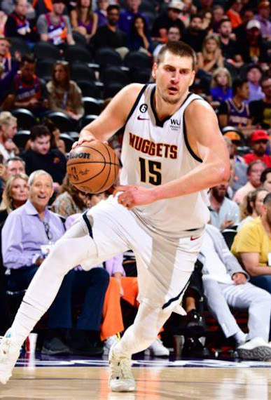
Questions
How do we determine which players are the most efficient?
What areas on the court are the high probability zones?
Which players perform well under pressure?

Slide 4
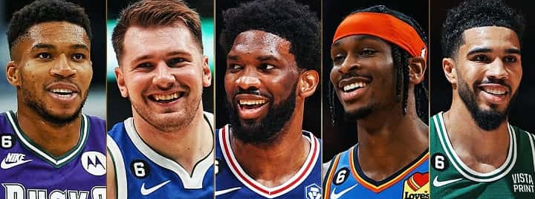
Data Source
This dataset is from the 2022-2023 NBA Season shot statistics.
This comes from the Basketball Reference Website.
Basketball Reference keeps track of all NBA statistics throughout each season every year.
This dataset contains a total of 217,221 rows.

Slide 5
Feature Engineering
Time Remaining Calculation: A new feature, time_remaining, is created by combining the minutes (MINS_LEFT) and seconds (SECS_LEFT) remaining in a quarter.
Shot Distance Feature: A SHOT_DISTANCE feature is engineered using the Pythagorean theorem to calculate the Euclidean distance of the shot from the basket based on LOC_X and LOC_Y coordinates.
Shot Zone Classification: Shots are categorized into different zones—Paint, Mid-Range, and 3PT—based on their calculated shot distance (SHOT_DISTANCE).

Slide 6
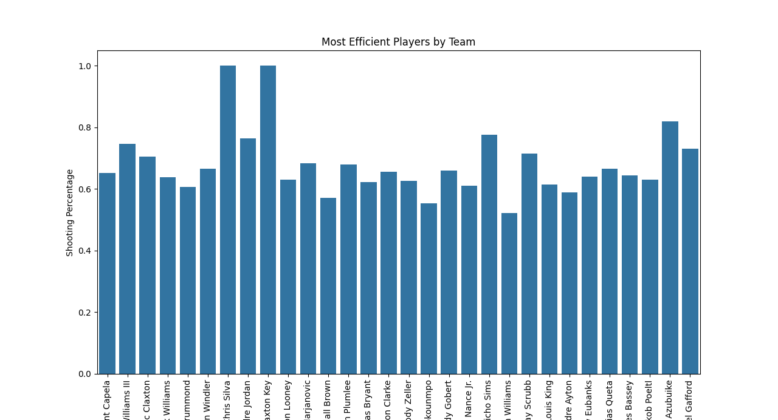
What Players Are The Most Efficient?
In this graph we have the most efficient players on all 30 NBA teams
This graph is generated using Python with features that contain, shot distance, and shot zone

Slide 7
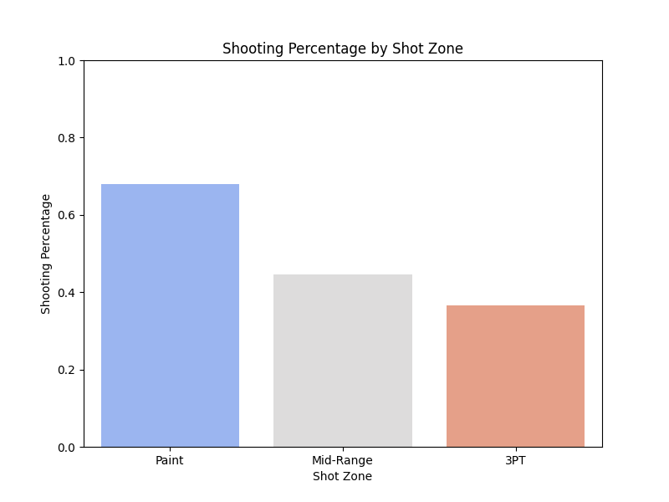
Where Are The High Percentage Zones?
The data shows that the closer the players are to the basket, the higher the shooting percentage.
zone_efficiency = df.groupby('SHOT_ZONE')['SHOT_MADE'].mean().reset_index()
This calculates the average shooting percentage for each shot zone

Slide 8
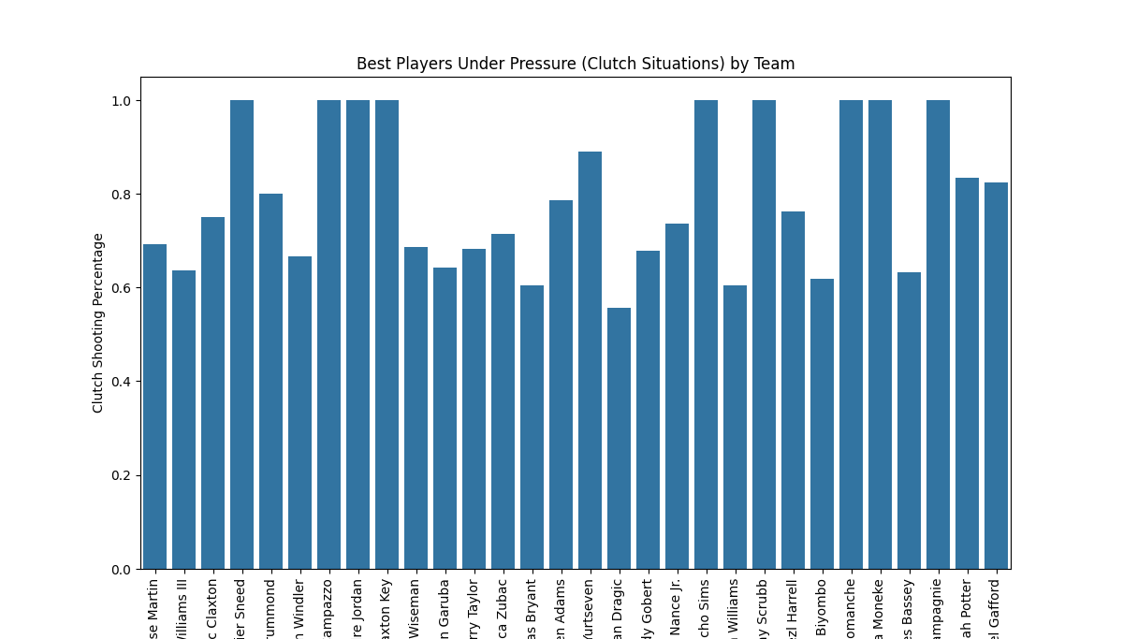
What Players Perform Well Under Pressure?
The bar plot shows the players with the highest shooting efficiency in clutch moments, grouped by team.
df['is_clutch'] = np.where((df['QUARTER'] >= 4) & (df['time_remaining'] <= 300), 1, 0)
This code creates the column ‘is_clutch’ which contains shots in the 4th quarter under 5 minutes or less

Slide 9

Data Insights
The most efficient player on a team may not always be the most popular.
Better players tend to take a lot more shots which can affect their efficiency.
Shots that are closer to the basket are the higher percentage shots.

Slide 10

Product of our Data
Shot Analyzer
Shot Analyzer will ingest Basketball Reference Website data from many NBA Seasons The Shot Analyzer application will create a player profile for NBA players and match their shot records with All-Timers and Hall of Famers.

Slide 11

Future Outlook
In the early stages of the project, we could not find good datasets to answer our earlier project ideas.
Some datasets were found but could not be properly ingested and wrangled. Some good datasets were found but were not large enough to answer the project questions.
If we had more time within this project, we would incorporate Machine Learning to see if there is a "perfect spot" to shoot from on the floor.

Slide 12
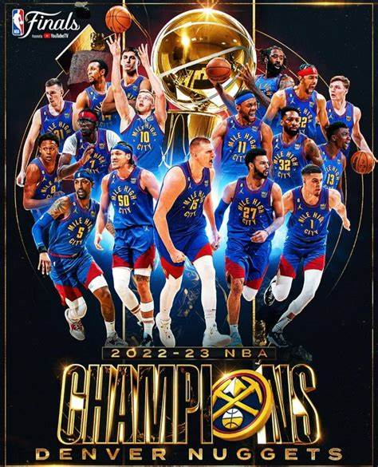
Conclusion
Overall NBA teams should have their most efficient players on the floor to have a better chance at winning.
Teams should design their offenses in a way that creates opportunities for high percentage shots.
Lastly in close games in the 4th quarter teams should create shots for their most clutch player.

Slide 13

Thank You!

